Slide 1
Thinking about loss...
A way to measure your accuracy
Laurence Moroney, Google

Slide 2

Matching X to Y
X = { -1, 0, 1, 2, 3, 4 }
Y = { -3, -1, 1, 3, 5, 7 }
Notes:
Image is public domain cc0: https://pixabay.com/photos/thinking-person-person-thinking-2681494/

Slide 3
Make a guess!
Y = 3X - 1
X = { -1, 0, 1, 2, 3, 4 }
Y = { -4, -1, 2, 5, 8, 11 }

Slide 4
How good is the guess?
Y = 3X - 1
X = { -1, 0, 1, 2, 3, 4 }
My Y = { -4, -1, 2, 5, 8, 11 }
Real Y = { -3, -1, 1, 3, 5, 7 }

Slide 5
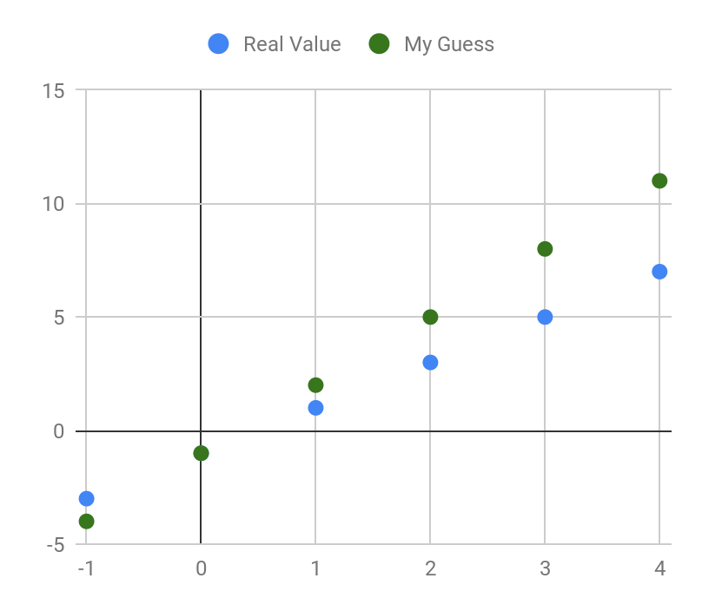
Let’s measure it!

Slide 6
Let’s measure it!

Slide 7
Let’s measure it!
4
3
2
1
0
-1

Slide 8
Let’s measure it!
4
3
2
1
0
-1

Slide 9
Houston, we have a problem!
4
3
2
1
0
-1

Slide 10

What if we square² them?
16
9
4
1
0
1
Notes:
Image is public domain cc0: https://pixabay.com/photos/idea-pointing-raise-hand-raise-3082824/

Slide 11
Total that (∑) and take the square root √
sqrt(1 + 1 + 4 + 9 + 16)
= sqrt(31)
= 5.57
Notes:
Image is public domain cc0: https://pixabay.com/photos/idea-pointing-raise-hand-raise-3082824/

Slide 12
Make another guess!
Y = 2X - 2
X = { -1, 0, 1, 2, 3, 4 }
My Y = { -4, -2, 0, 2, 4, 6 }
Real Y = {-3, -1, 1, 3, 5, 7}
Diff² = {1, 1, 1, 1, 1}
Notes:
Image is public domain cc0: https://pixabay.com/photos/thinking-person-person-thinking-2681494/

Slide 13

Get the same difference, repeat the same process.
sqrt(1 + 1 + 1 + 1 + 1)
= sqrt(5)
= 2.23
Notes:
Image is public domain cc0: https://pixabay.com/photos/excited-person-happy-young-woman-3126449/

Slide 14

Make another guess!
Y = 2X - 1
X = { -1, 0, 1, 2, 3, 4 }
My Y = { -3, -1, 1, 3, 5, 7 }
Real Y = {-3, -1, 1, 3, 5, 7}
Diff² = {0, 0, 0, 0, 0}
Notes:
Image is public domain cc0: https://pixabay.com/photos/sunglasses-cool-fashion-style-2649326/

Slide 15
Your turn!

